Slide 1


Miami, A Growing City With Remarkable Opportunities
Team Gazelle​
Egor Zhogov
Fabianna Rodríguez-Mercado​
Hojin Lee​
Shenjie Qiu ​
Notes:
Shenjie

Slide 2
Miami stands out from 35 Metropolitans
Rank of Market Potential ​ Index​ | Metropolitan​ | Population​ (2020)​ | EJ Advisor number (2021)​ | Population/ Advisor | Affordability​ Index​* | Market Potential index​**
1​ | Miami​ | 6,138,333​ | 45​ | 136,407 | 7.1​ | 19,160​
14​ | Atlanta​ | 6,089,815​ | 272​ | 22,389 | 7.3​ | 3,399​
35​ | Seattle​ | 4,018,762​ | 450​ | 8,931 | 8.8​ | 1,013​
The Market potential index of Miami is almost 20 times higher than Seattle.
* Affordability = Median house price/Median income
**Market Potential Index= (Population/Advisor number) / Affordability Index
Notes:
Shenjie

Slide 3
SWOT Analysis of Edward Jones in Miami
Strengths
Served individual investors
Retention of financial advisors from a variety of professions
Established long-lasting customer relationship management
Well-disciplined service
Conservative investment
Weaknesses
Limited number of EJ resources available in Miami
Increased complex products required by customers
Higher quality service & stronger relationship with EJ Advisors required by investors
Slow to adapt to technological changes
S
W
Opportunities
Income tax free, population growth >10%
The 6th fastest growing region in the US with an increasing number of old people/retirees
Lower poverty rate compared to other cities
Vast public transportation system
O
T
Threats
Stagnancy of business activities and economic shrinkage due to COVID-19
Increasing online services and technologies
Customers have more knowledge due to the increased access to information with all new technologies
High rent in Miami
Notes:
Hojin.

Slide 4

Strategic Proposed Market Expansion in Miami
To grow to 200 financial advisors in Miami by 2030, by offering trusted and convenient face-to-face financial advice to conservative individual investors in stocks, bonds, mutual funds and ETFs, through a network of one-financial adviser offices.
Notes:
Fabianna

Slide 5
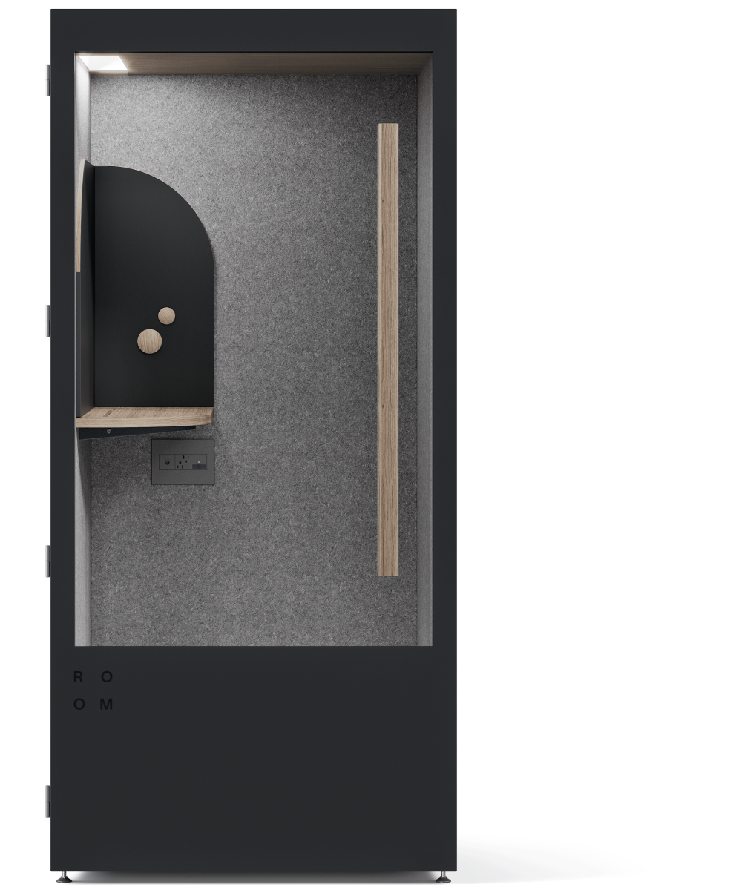
Economic Objective
Increase net revenue 5x in 5 years, comparable to the current profit in Atlanta.
Implementation
Share offices with other businesses but ensure private space for customers.
Rent offices close to the public transportation system in the city.
Incorporate convenient mini video booth office.
Notes:
Egor

Slide 6

Thank you!
Team Gazelle
Egor Zhogov
Fabianna Rodríguez- Mercado
Hojin Lee
Shenjie Qiu
Notes:
Egor

